Slide 1
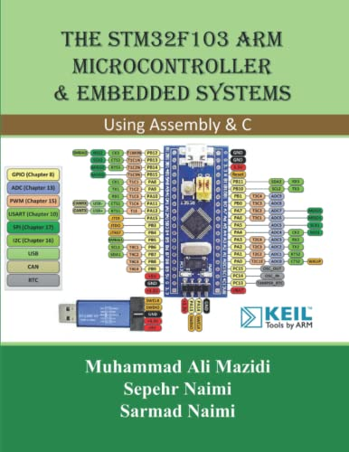
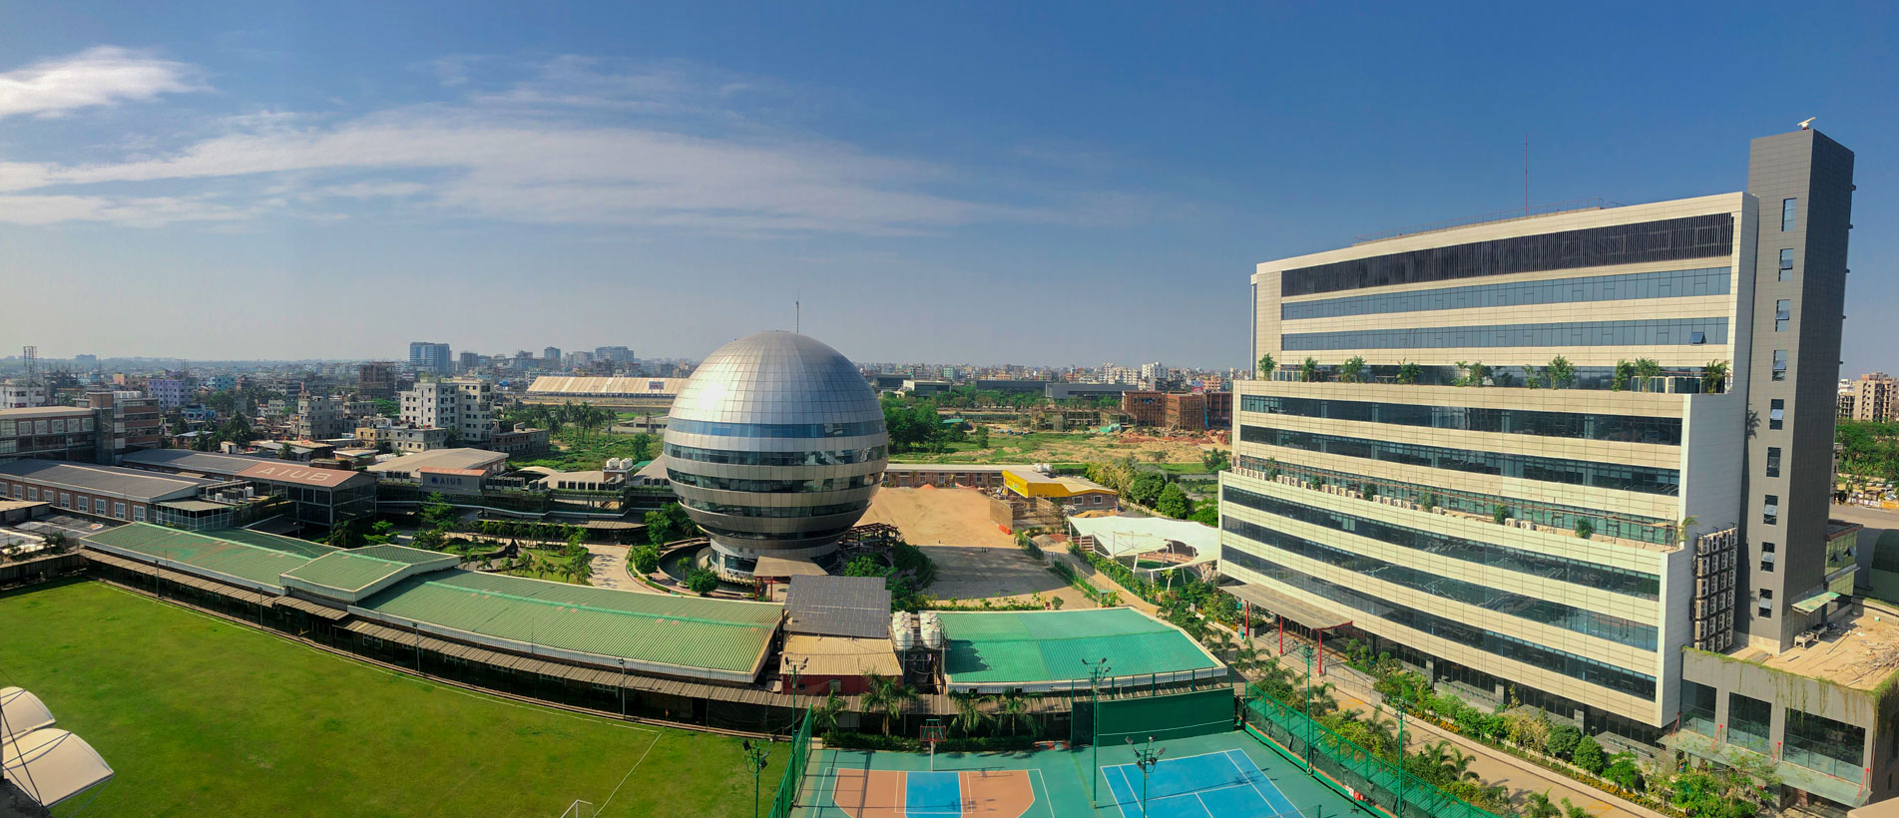
Lecture # 02M
Prof. Dr. Engr. Muhibul Haque Bhuyan
Professor, Department of EEE
American International University-Bangladesh (AIUB)
Dhaka, Bangladesh

Slide 2


Introduction to Timers
AMERICAN INTERNATIONAL UNIVERSITY – BANGLADESH (AIUB)
Where leaders are created
By Nowshin AlAm

Slide 3
What is a Timer?
A timer/counter is like a clock and can be used to measure time events.
B7 | B6 | B5 | B4 | B3 | B2 | B1 | B0
0 | 0 | 0 | 0 | 0 | 0 | 0 | 0
0 | 0 | 0 | 0 | 0 | 0 | 0 | 1
0 | 0 | 0 | 0 | 0 | 0 | 1 | 0
0 | 0 | 0 | 0 | 0 | 0 | 1 | 1
0 | 0 | 0 | 0 | 0 | 1 | 0 | 0
0 | 0 | 0 | 0 | 0 | 1 | 0 | 1
. | . | . | . | . | . | . | .
1 | 1 | 1 | 1 | 1 | 1 | 1 | 1

Slide 4
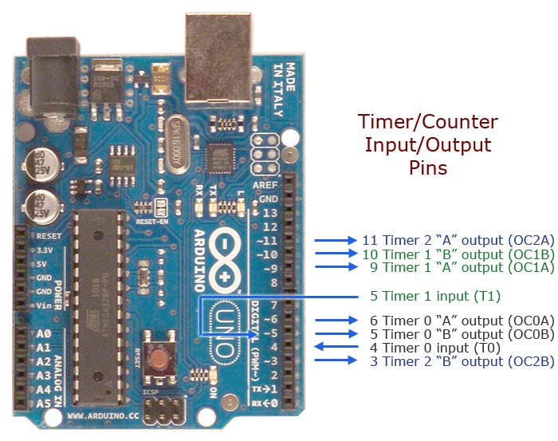
What is a Timer?
The timer can be programmed by some special registers.
The controller of the Arduino is the ATmega328, which has 3 timers, called Timer0, Timer1 and Timer2.

Slide 5
What is a Timer?
Timer0 and Timer2 are 8-bit timers, whereas Timer1 is a 16-bit timer. The most important difference between 8-bit and 16-bit timers is the timer resolution.
8-bit timer is capable of counting 2⁸ = 256 steps from 0 to 255. 16-bit timer is capable of counting 2¹⁶ = 65536 steps from 0 to 65535.
PB5-0
PD7-0

Slide 6
Usefulness of Timer :
Timer is an important concept in the field of electronics. Every electronic component of a sequential logic circuit works on a time base to keep all the work synchronized.
An advantage of the timer is that it is totally independent of the CPU. Thus, it runs parallel to the CPU and there is no CPU’s intervention, which makes the timer quite accurate.
This is why using a timer is preferred for long delays instead of simply using the delay() function. The drawback of delay() is that your loop gets halted, and functions above and below the delay() are not being executed during this interval.

Slide 7
Usefulness of Timer :
A timer approach is a little harder to implement but the main loop keeps executing and only excludes the code and functions which a programmer wants to exclude.
If the programmer needs multiple tasks to occur at the same time or if the programmers' application requires that you constantly read/save data from inputs, use of the delay() function should be avoided.

Slide 8
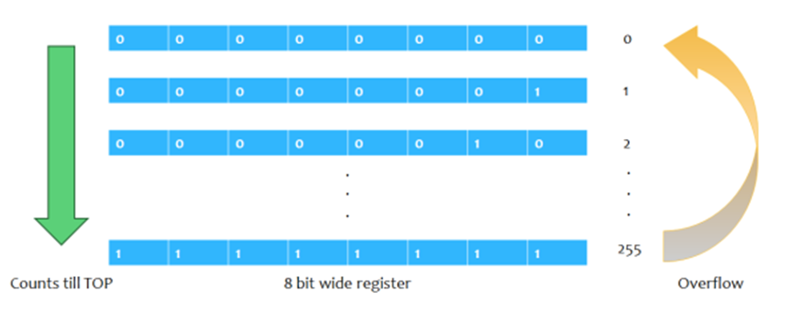
Timer Basics: Overflow
Due to this counting feature, timers are also known as counters. Once they reach their maximum possible value, the program does not stop executing and the timer count simply returns to its initial value of zero. In such a situation, we say that the timer/counter overflows.
For example, Timer0 is an 8-bit timer, meaning that it can count up from zero to 2⁸-1, or 255. Once that number is reached, the count resets back to zero and starts counting again.

Slide 9
How Timer Works?
Timers on the Arduino count up from zero, incrementing with every clock cycle of the oscillating crystal that drives Arduino.
If smaller frequencies are necessary, it is possible to “divide” the clock through an approach called pre-scaling.
How quickly timer reaches the target count depends on the clock divider. With no divider, the clock would go through 16 million cycles per second (16 MHz), and would overflow and reset this counter many times per second.
The three timers (called Timer0, Timer1, and Timer2) of Atmega328 can either be operated in one of these three modes, called normal mode, CTC mode, or PWM mode.
For lab experiment 3, we will operate it in normal mode (counter) using Timer0.

Slide 10
Timer Basics: Registers (Timer0)
The timer can be programmed by some special registers, where we can configure the pre-scaler for the timer, or the mode of operation and many other things necessary for proper operation.
The registers of interest for our purposes are:
Timer/Counter Register – TCNT0: to store timer count
Timer/Counter Control Register – TCCR0A and TCCR0B: to define operation mode and pre-scaler
Timer/Counter Interrupt Flag Register– TIFR0: to observe if there is any overflow
Output Compare Register - OCR0A and OCR0B: to match the timer count with some custom value (for CTC or PWM mode, not needed for normal mode)

Slide 11


Timer Basics: Registers (Timer0)
Timer/Counter Control Register A for Timer0 – TCCR0A: The bits WGM02 (from TCCRB), WGM01 and WGM00 decide which mode the timer will run on.
Timer/Counter Control Register B for Timer0 – TCCR0B: The three Clock Select bits- CS02, CS01, CS00 select the clock source and pre-scalar value to be used by the Timer/Counter

Slide 12
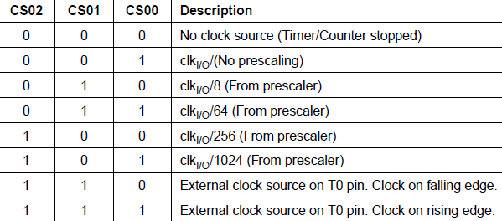
Timer Basics: Registers (Timer0)
Please note that if you do not initialize this register, all the bits will remain as zero and the timer/counter will remain stopped.

Slide 13

Timer Basics: Registers (Timer0)
Timer/Counter Register – TCNT0:
This is where the 8-bit counter of the timer resides.
The value of the counter is stored here and increases or decreases automatically.
Data can be both read or written from this register.
The register resets to zero after each overflow.

Slide 14



Timer Basics: Registers (Timer0)
Timer/Counter Interrupt Flag Register– TIFR0:
TOV0 bit is set (one) whenever TIMER0 overflows.
Output Compare Register - OCR0A and OCR0B:
Both Output Compare Registers A and B contain 8-bit values that are continuously compared with the counter value (TCNT0).
The OCF0A or OCF0B bit in the TIFR register is set (one) whenever the count matches the stored value in OCR0A/B.

Slide 15
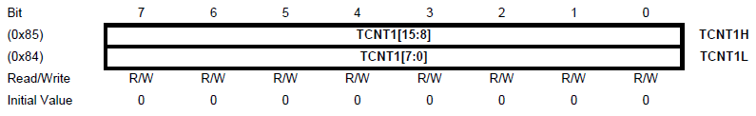
Timer Basics: Registers (Timer1)
Most of the registers are very similar to Timer0.
Timer/Counter Register – TCNT1H and TCNT1L (TCNT1):
The main difference between Timer0 and Timer1 is in the timer/counter register.
The two Timer/Counter I/O locations (TCNT1H and TCNT1L, combined TCNT1 of 16-bit) give direct access, both for read and write operations, to the Timer/Counter unit 16-bit counter.
The register resets to zero after each overflow.

Slide 16
Timer Basics: Registers (Timer1)
Most of the registers are very similar to Timer0. TCCR1A, TCCR1B, and TIFR1 registers are of 8-bits, but they have some extra bits.
The other differences include
Like the Timer/Counter Register (TCNT1 ≡ TCNT1H:TCNT1L), the output compare registers (OCR1A and OCR1B) are also 16 bit and made up from two 8-bit registers, i.e., OCR1A ≡ OCR1AH:OCR1AL and OCR1B ≡ OCR1BH:OCR1BL.
There is an extra Input Capture bit in TIFR1 Register.
There are several extra modes Timer1 can run on.

Slide 17
Timer Basics: Terminology
Definitions of some commonly used terms in Timer:
BOTTOM: The counter reaches the BOTTOM when it becomes 0x00.
MAX: The counter reaches its maximum when it becomes 0xFF (decimal 255) in Timer0 and 0xFFFF (decimal 65535) in Timer1.
TOP: The counter reaches the TOP when it becomes equal to the highest value in the count sequence. The TOP value can be assigned to be the fixed value (MAX) or the value stored in the OCRnA or OCRnB Register. The assignment is dependent on the mode of operation.

Slide 18
Timer Modes: Normal Mode
The simplest mode of operation is the Normal mode. In this mode, the counting direction is always up (incrementing), and no counter clear is performed.
The counter simply overflows when it passes its maximum value and then restarts from zero.
In normal mode of operation, the Timer/Counter Overflow Flag (TOV0) will be set in the same timer clock cycle as the TCNT0 becomes zero.

Slide 19
Timer Modes: Clear Timer on Compare, CTC Mode
In Clear Timer on Compare or CTC mode, the counter is cleared to zero when the counter value (TCNT0) matches either a value stored in OCR0A register.
When the desired value is reached, a flag in a status register is set to ‘1’.
This method can be more efficient than comparing bytes to detect a match as checking a single flag is simpler.

Slide 20
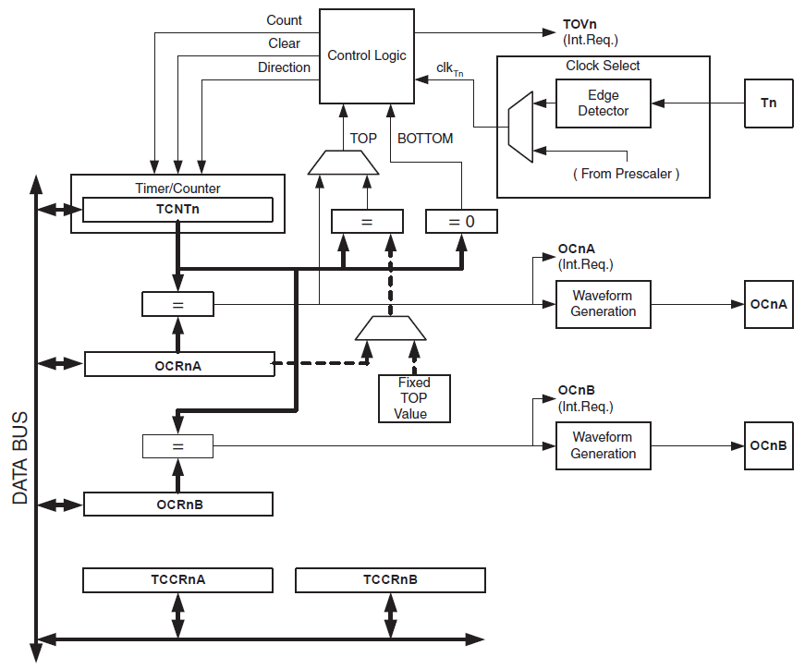
Counter Unit
Red: signals entering/exiting a block
Green: description of a block
2a. Every clock period, signals the Timer to increment/decrement
3c. Timer/Counter overflow flag set when timer overflows (goes beyond maximum value)
Red: signals entering/exiting a block
Green: description of a block
Red: signals entering/exiting a block
Green: description of a block
2b. Sets the timer’s count to zero
2c. Chooses between increment and decrement
1. Timer clock is chosen
0a. External clock source
Contains the current timer count
3a. Signals that timer count has reached maximum
3b. Signals that timer count has reached minimum
0b. System clock (may or may not be pre scaled)

Slide 21
Output Compare Unit
6a. Signals that timer count has reached maximum
6b. Signals that timer count has reached minimum
Comparator (checks if zero)
Comparator
1. Current timer count
OCFnA
7a. Output compare flag set, interrupt generated if enabled
1. Current timer count
5. Maximum timer value chosen
Comparator
3a. Sends signal if inputs equal
8a. generate a
PWM or variable frequency output
2a. Count stored in OCRnA
4. Count stored in OCRnA
OCFnB
7b. Output compare flag set, interrupt generated if enabled
1. Current timer count
Comparator
2b. Count stored in OCRnB
3b. Sends signal if inputs equal
8b. generate a
PWM or variable frequency output
Red: signals entering/exiting a block (Normal mode)
Blue: signals entering/exiting a block (CTC/PWM mode)
Green: description of a block

Slide 22
Control Unit
decides which mode the timer will run on and decides the pre-scaler for the timer clock

Slide 23
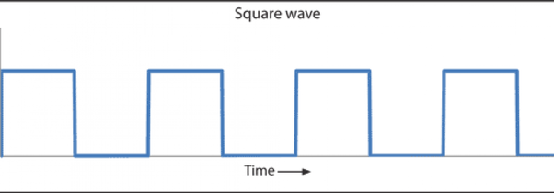
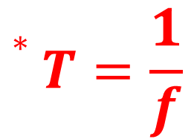
Timer for Delay: Calculating Count
Timer needs a clock pulse for each transition from one number to the next, so we want to establish a formula relating the necessary timer counts for a specific delay with the timer clock period/frequency.
For F_CPU, f = 16 MHz, the system clock period, T = 1/16MHz = 62.5 ns*. So, if the timer clock is the same as the system clock, it takes only 62.5 ns for every transition (0 to 1, 1 to 2, etc.).
187.5 ns
$$∗T=\frac{1}{f}$$
62.5 ns
62.5 ns
62.5 ns
Count = 0
Count = 1
Count = 2

Slide 24

Timer for Delay: Calculating Count
We can see that 3 time periods are needed to count from 0 to 2, so timer count = (number of time periods needed to reach the count) -1.
That is, to get a delay of 187.5 ns, we need 3 time periods lasting 62.5 ns, i.e., 62.5 ns x 3 = 187.5 ns
So, $\text{N}\text{umber} \text{of} \text{periods} \text{needed}=\frac{ \text{Required} \text{delay}}{\text{Timer} \text{clock} \text{period}}$.
187.5 ns
62.5 ns
62.5 ns
62.5 ns
Count = 0
Count = 1
Count = 2

Slide 25

Timer for Delay: Calculating Count
Suppose, we need a delay of 1 ms. To get an idea of how long it takes, let’s calculate the timer count from the following formula:
$$Timer count=\frac{Required delay}{Timer clock period}−1$$ Here, required delay = 1 ms and timer clock period = 62.5 ns, so Timer Count = (1000000ns/62.5ns) – 1 = 15,999.
So, the clock needs to tick 15,999 times to give a delay of only 1 ms.

Slide 26
Timer for Delay: Calculating Count
Maximum possible delay for Timer0 (which is an 8-bit timer) at 16 MHz: 62.5 ns × 256 = 16 μs
Maximum possible delay for Timer1 (which is a 16-bit timer) at 16 MHz: 62.5 ns × 65,536 = 4.096 ms
If we plan to get delays simply by directly counting at system frequency, it is difficult to use an 8-bit timer (as it has an upper limit of 255, after which it overflows, and resets the count to zero). Even with a 16-bit timer (which can count to 65,535), it is not possible to get longer delays.

Slide 27
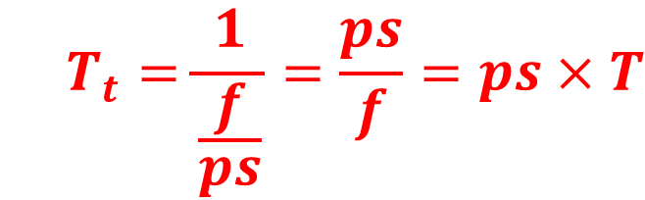
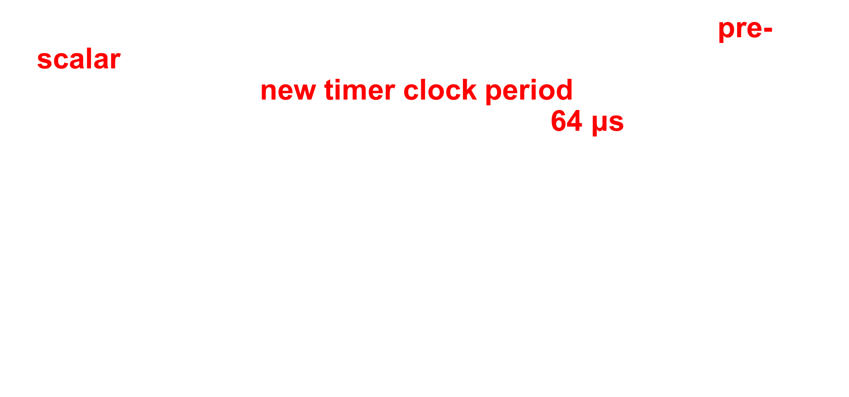
Timer for Delay: Calculating Count
To stay in the safe side, we use the highest available pre-scalar and reduce timer clock frequency to 16MHz/1024 = 15625 Hz, with a new timer clock period (= System clock period × pre-scalar) = 62.5ns×1024 = 64 μs. Now, the needed timer count = (1ms/64μs) – 1 = 14.625. Now that Timer clock frequency, f_{t} = System clock frequency, f/pre-scalar, ps, we can update the equation
$$Timer count=\frac{Required delay}{Timer clock period, T_{t}}−1$$
to
$$Timer count=\frac{Required delay}{prescalar (ps)×T}−1$$
$$T_{t}=\frac{1}{\frac{f}{ps}}=\frac{ps}{f}=ps×T$$

Slide 28
Timer for Delay: Calculating Count
Maximum possible delay for Timer0 at 15625 Hz: 64 μs × 256 = 16.384 ms
Maximum possible delay for Timer1 at 15625 Hz: 64 μs × 65536 = 4.194304 s
To get longer delays, we will use Timer1, and for delays longer than 4 s, nested if statements can be used.

Slide 29
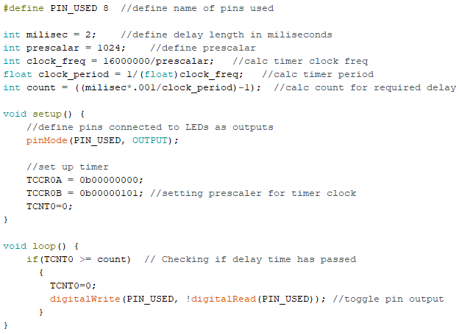
Problem Statement 1
Make an LED blink every 2 milliseconds while using Arduino system frequency (F_CPU) 16 MHz, using timer to generate the delay without any application of delay() function. Delay = 2 ms, so Timer0 can be used with pre-scalar 1024.
Number of count needed to reach 2 ms = (2,000 μs/64 μs) – 1 = 30.25 ≈ 31 << 255.
WGM01 and WGM00 are set to zero for normal mode
WGM02 is set to zero for normal mode; CS02, CS01, CS00 are set to 1, 0, 1 for a pre-scalar of 1024
Make the LED blink

Slide 30
Problem Statement 2
Make an LED to blink every 2 seconds while using Arduino system frequency (F_CPU) 16 MHz, using a timer to generate the delay without any application of delay() function.
Delay = 2 s, so Timer1 (remember that it is a 16-bit timer) can be used with the pre-scalar value of 1024.
Number of count required to get a delay of 2 s = (2,000,000 μs/64 μs) – 1 = 31,249 >> 255.

Slide 31
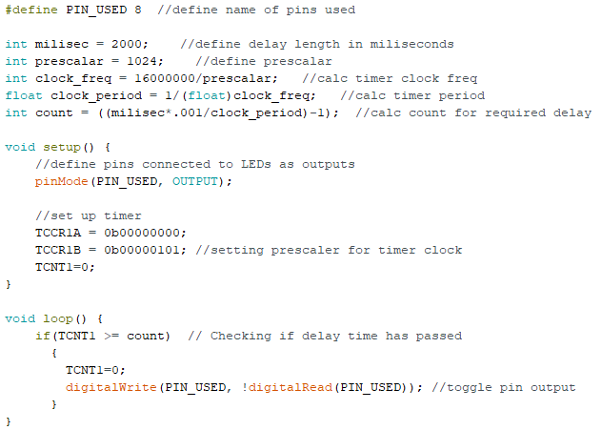
Code:
Same code, only register names have 1 instead of 0 and delay length changed!
Set-up registers are 8-bits, even though the Timer1 is 16-bit

Slide 32
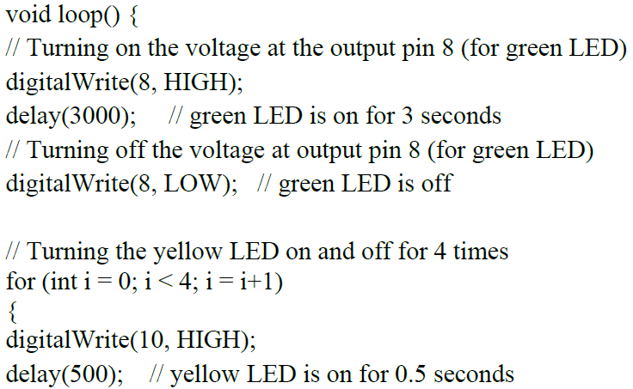
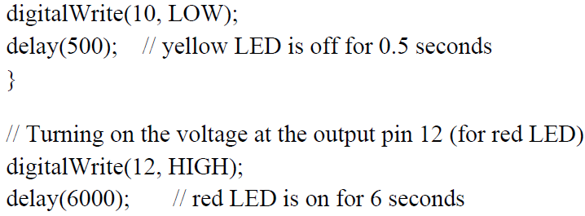
Old Code using the delay() Function for the Traffic Control
To-do list for changing the program:
Initialize timer registers
Write a customized delay function using a timer
Change the marked lines

Slide 33
Code for the Timer0 Function
// declaring the timer function to count 1 ms of delay instead of calling the delay function
int delay_timer (int milliseconds){
int count = 0;
while(1)
{
if(TCNT0 >= 15) // checking if 1 millisecond has passed
{
TCNT0 = 0;
count++;
if (count == milliseconds) //checking if required milliseconds delay has passed
{
count = 0;
break; // exits the loop
}
}
}
return 0;
}
* Delay = 1 ms, so Timer0 can be used with pre-scalar 1024.
The number of counts needed to reach 1 ms = (1,000 μs/64 μs) – 1 = 15.625 -1
= 14.65 ≈ 15.

Slide 34
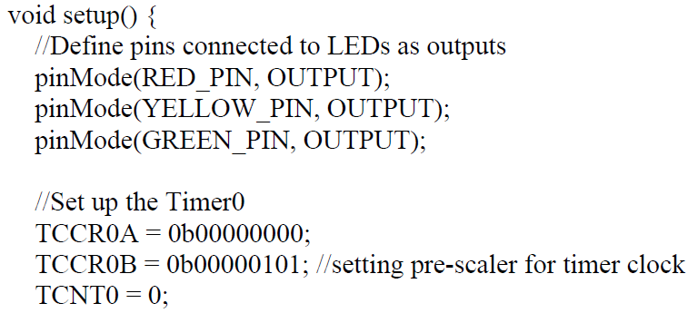
Modified Code using Timer0 for the Traffic Control

Slide 35
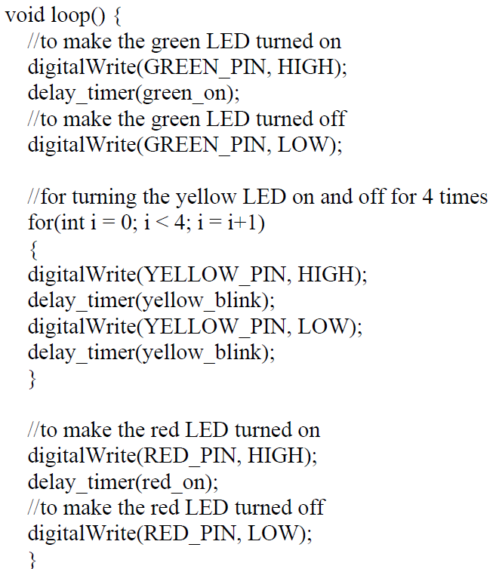
Modified Code using Timer0 for the Traffic Control
Change the marked lines with the new function, delay_timer() inside the lop.

Slide 36

Example 1:
If you want to make an LED of blue color blink every 2 seconds while using an Arduino system frequency of 16 MHz using a timer to generate delay without any application of the built-in delay() function, select a suitable timer of the Arduino Uno for your application. Use a pre-scaler value of 256. Determine the necessary register set-up required for the program. A table of clock-select bits and register structures is given at the end of this question paper.
Solution:
Required delay = 2 s = 2000000 μs; Given system frequency = 16 MHz
So, clock period = 1/frequency = 1/16 MHz = 0.0625 μs
As such,
$$Timer count=\frac{Required delay}{prescalar (ps)×T}−1=\frac{\text{2000000}}{256×\text{0.0625}}−1=1,24,999$$

Slide 37
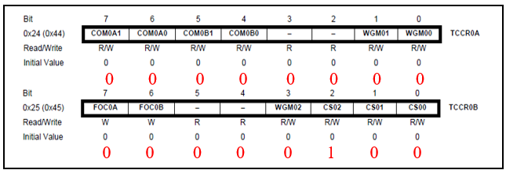
Example 1:
Timer 0 can count up to 256 and Timer 1 can count up to 65,536; so, neither Timer0 nor Timer1 of Arduino is suitable for this application, but with the use of a Timer Function Sub-Program that can generate 1 ms of delay upon each call of the function, any one timer may be used for 10 s time calculation. The timer will run in normal mode as such all values of the timer counter control registers (TCCRnx, here n = 0/1 and x = A/B) will be zero except for the clock select bits (CSn2:0) of the pre-scaler value of 256 in the TCCR0B or TCCR1B will be 100. If we use Timer0 then the register setup will be as follows:
Prescaler values and corresponding register contents.
CSx2 | CSx1 | CSx0 | Prescaler
0 | 0 | 1 | 1
0 | 1 | 0 | 8
0 | 1 | 1 | 64
1 | 0 | 0 | 256
1 | 0 | 1 | 1024

Slide 38
Example 2:
Determine the outputs of the program and correct the program if there are any errors. Assume that a green color LED is connected to pin 5 and the Arduino frequency is 16 MHz. Compute the number of counts required for a 3 ms delay in each cycle for the given delay. Compute the number of times the while_true loop will run to execute the delays of LED ON/OFF times. Use a pre-scaler value of 1024.
#define YELLOW_PIN 10
int blue_on = 5000; // delay is given in ms
int red_off = 4000; // delay is given in ms
int delay_timer (int milliseconds){
int count = 0;
while(1) {
if(TCNT1 >= _____) {
TCNT1=0;
count++;
if (count == milliseconds) {
count=0;
break; }
}
}
return 0;
}
void loop() {
pinMode(GREEN_PIN, INPUT);
TCCR0A = 0b00000000;
TCCR0B = 0b00000100;
TCNT1 = 0x0000;
}
void loop() {
digitalWrite(BLUE_PIN, HIGH);
delay(green_on);
digitalRead(GREEN_PIN, LOW);
delay_timer(blue_off);
void loop() {
pinMode(GREEN_PIN, INPUT);
TCCR0A = 0b00000000;
TCCR0B = 0b00000101;
TCNT1 = 0x0000;
}
void loop() {
digitalWrite(BLUE_PIN, HIGH);
delay(green_on);
digitalRead(GREEN_PIN, LOW);
delay_timer(blue_off);
Prescaler values and corresponding register contents.
CSx2 | CSx1 | CSx0 | Prescaler
0 | 0 | 1 | 1
0 | 1 | 0 | 8
0 | 1 | 1 | 64
1 | 0 | 0 | 256
1 | 0 | 1 | 1024

Slide 39
void loop() { setup
pinMode(GREEN_PIN, INPUT); OUTPUT
TCCR0A = 0b00000000; TCCR1A
TCCR0B = 0b00000101; TCCR1B
TCNT1 = 0x0000;
}
void loop() {
digitalWrite(BLUE_PIN, HIGH); GREEN_PIN
delay(green_on); delay_timer
digitalRead(GREEN_PIN, LOW); digitalWrite
delay_timer(blue_off); green_off
}
}
Example 2:
Solution:
Corrected Codes
#define YELLOW_PIN 10 GREEN_PIN 5
int blue_on = 1667; // delay is given in ms green_on
int red_off = 1333; // delay is given in ms green_off
int delay_timer (int milliseconds){
int count = 0;
while(1) {
if(TCNT1 >= 46) {
TCNT1=0;
count++;
if (count == milliseconds) {
count=0;
break; }
}
}
return 0;
}

Slide 40

Example 2:
The output of the program is: A green LED connected to pin 5 will be turned ON for 5 s and OFF for 4 s and this ON-OFF status will be repeated indefinitely after correcting the program (shown in the program above with the wrong parts stroked through in red color) until the microcontroller’s power is turned OFF.
Given system frequency = 16 MHz; So, clock period = 1/frequency = 1/16 MHz = 0.0625 μs
Required delay = 3 ms = 3000 μs
$$Timer count=\frac{Required delay}{prescalar (ps)×T}−1=\frac{\text{3}\text{000}}{1024×\text{0.0625}}−1=46$$
The number of loop counts required for a 5 s (5000 ms) delay in each cycle for the LED ON duration = 5000 ms/3 ms = 1667. The number of loop counts required for a 4 s (4000 ms) delay in each cycle for the LED OFF duration = 4000 ms/3 ms = 1334.
Timer0 can count up to 255 and Timer1 can count up to 65,535. Therefore, both Timer0 and Timer1 are appropriate for this application.

Slide 41

Example 3:
If you want to make an LED of red color blink every 4 seconds while using an Arduino system frequency of 16 MHz using a timer to generate the delay without any application of the delay() function, which timer of the Arduino Uno is suitable for your application? You may use a pre-scaler value of 1024. Write the necessary set-up function to configure the control registers required for the program.
Solution:
Given system frequency = 16 MHz; So, clock period = 1/frequency = 1/16 MHz = 0.0625 μs; Required delay = 4 s = 4000000 μs
$$Timer count=\frac{Required delay}{prescalar (ps)×T}−1=\frac{\text{4}\text{000}000}{1024×\text{0.0625}}−1=62499$$
But Timer 0 can count up to 255 and Timer 1 can count up to 65,535; so Timer1 is suitable for this application.

Slide 42
Example 3:
void setup() {
pinMode(REDLED_PIN, OUTPUT);
TCCR1A = 0x00; // Since Timer1 is used, so control registers of Timer1
TCCR1B = 0x05; // are used in this program instead of registers of Timer0.
TCNT1 = 0x0000; // Timer1 must be initialized, first.
}

Slide 43
Example 4:
Determine the outputs of the program and correct the program if there are any errors. Assume that a red color LED is connected to pin 10 and the Arduino frequency is 16 MHz. Compute the number of counts required for a 2 ms delay in each cycle for the given delay. Compute the number of times the while_true loop will run to execute the delays of LED ON/OFF times. Use a pre-scaler value of 1024.
#define YELLOW_PIN 10
int red_on = 2000; // delay is given in ms
int red_off = 1000; // delay is given in ms
int delay_timer (int milliseconds){
int count = 0;
while(1) {
if(TCNT1 >= 16) {
TCNT1=0;
count++;
CSx2 | CSx1 | CSx0 | Prescaler
0 | 0 | 1 | 1
0 | 1 | 0 | 8
0 | 1 | 1 | 64
1 | 0 | 0 | 256
1 | 0 | 1 | 1024

Slide 44
Example 4:
if (count == milliseconds) {
count=0;
break; }
}
}
return 0;
}
void loop() {
pinMode(RED_PIN, INPUT);
TCCR0A = 0b00000000;
TCCR0B = 0b00000100;
TCNT1 = 0x0000; }
void loop() {
digitalWrite(RED_PIN, HIGH);
delay_timer(red_on);
digitalRead(RED_PIN, LOW);
delay(red_off); }

Slide 45

Example 4:
Solution:
Given system frequency = 16 MHz; So, clock period = 1/frequency = 1/16 MHz = 0.0625 μs; Required delay = 2 ms = 2000 μs
$Timer count=\frac{Required delay}{prescalar (ps)×T}−1=\frac{\text{2}\text{000}}{\text{10}\text{2}\text{4}\text{×}\text{0.0625}}−1=31.25−1≅31$
Since Timer 0 can count up to 255; so Timer0 is suitable for this application.
The number of counts required for a 2 s (2000 ms) delay in each cycle for the LED ON duration = 2000 ms/2 ms = 1000. The number of counts required for a 1 s (1000 ms) delay in each cycle for the LED OFF duration = 1000 ms/2 ms = 500.

Slide 46
Example 4:
void loop() { setup
pinMode(RED_PIN, INPUT); OUTPUT
TCCR0A = 0b00000000; TCCR1A
TCCR0B = 0b00000101; TCCR1B
TCNT1 = 0x0000;
}
void loop() {
digitalWrite(RED_PIN, HIGH);
delay_timer(red_on);
digitalRead(RED_PIN, LOW); digitalWrite
delay(red_off); delay_timer
}
#define YELLOW_PIN 10 // RED
int red_on = 2000; // delay is given in ms
int red_off = 1000; // delay is given in ms
int delay_timer (int milliseconds){
int count = 0;
while(1) {
if(TCNT1 >= 16) { 31
TCNT1=0;
count++;
if (count == milliseconds) {
count=0;
break; }
}
}
return 0;
}

Slide 47
References
ATMega328 manual
https://www.avrfreaks.net/forum/tut-c-newbies-guide-avr-timers
http://maxembedded.com/2011/06/avr-timers-timer0/

Slide 48
Thanks for attending….
?

